Slide 1
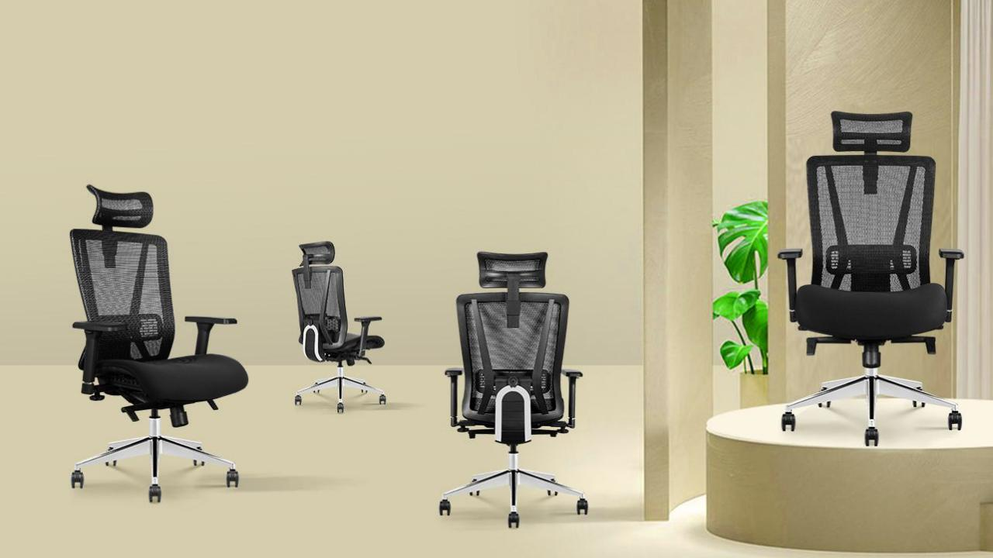
NOVA CHAIR

Slide 2
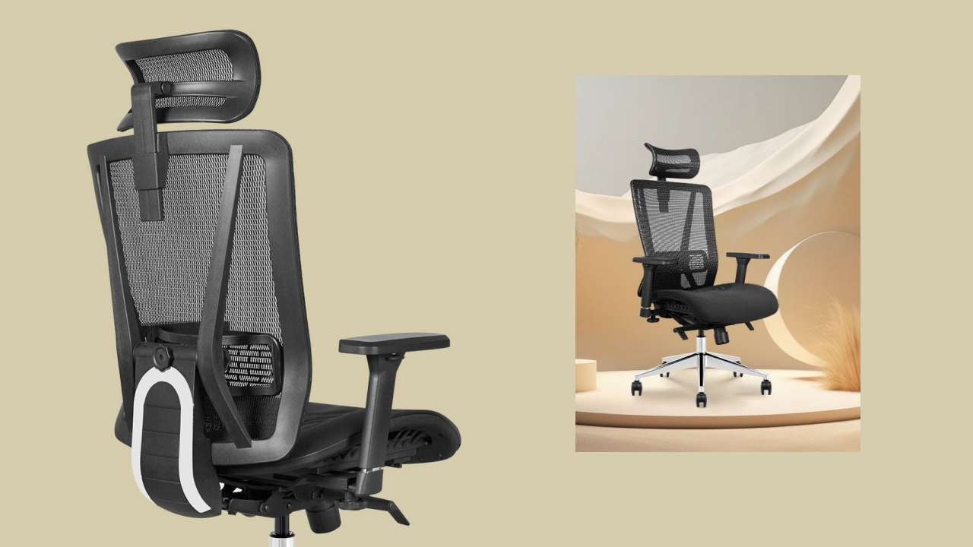
WORK&HOME
ACCURATE
Accurately find the support position in real time
Choose X3-01A-M ergonomic chair, you will find your physical and work performance improves, and this
improvement leads to greater productivity and creativity.

Slide 3
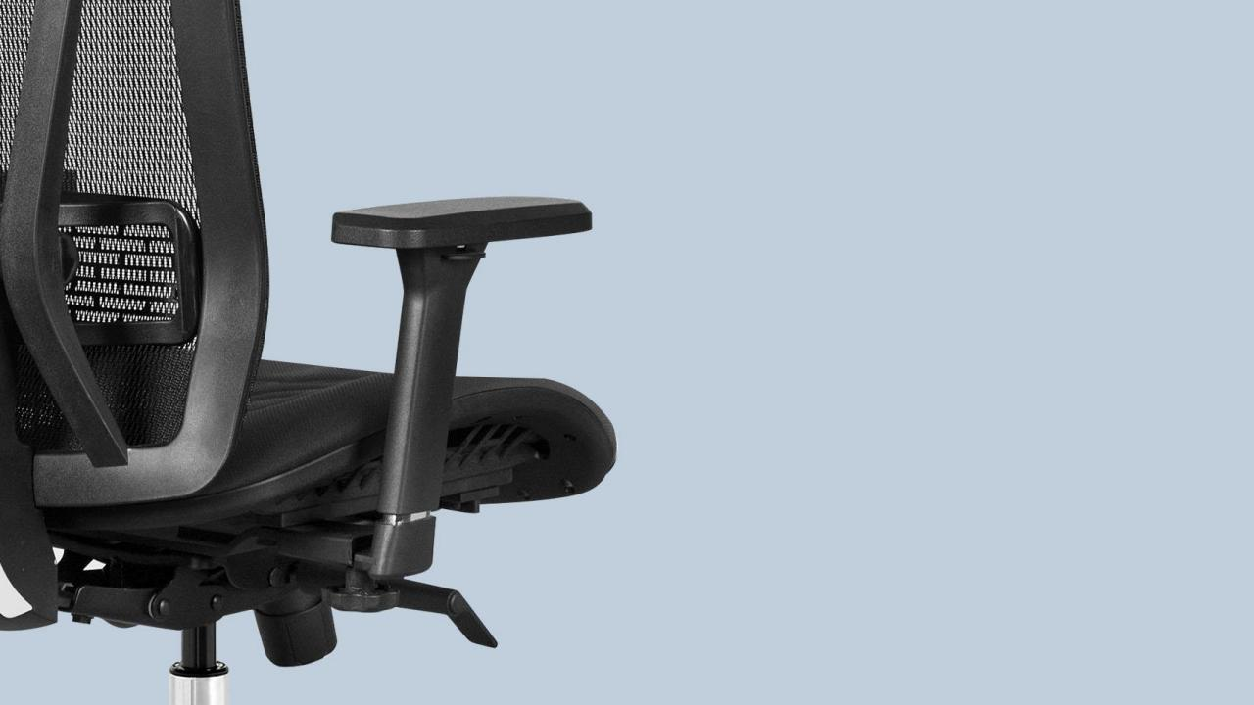
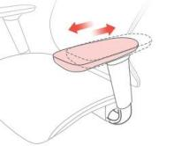
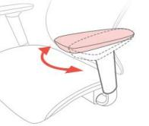
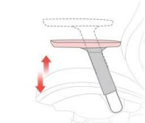
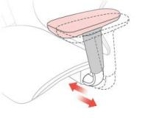
Armrest pad canslide back and forth
Armrest pad rotation
Arms height adjustment
Arms - width adiustment

Slide 4
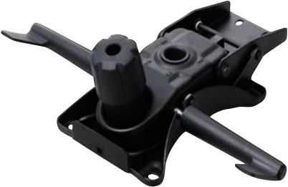
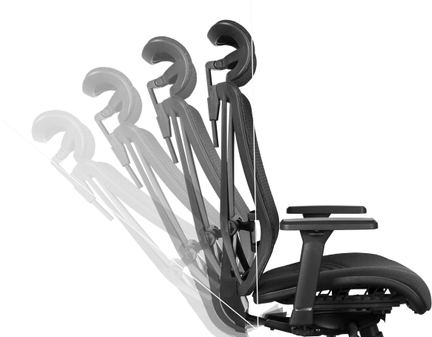
Synchronized Tilting Mechanism with
4 Positions Locking
B
C
A
Backrest Tilting degree
90。
118
。
A: If you pull up the lever, you can adjust the seat height.
B: If you pull up the lever, you can lock the back; if press down the lever, you can unlock the back.
C: If you turn the handwheel, you can adjust the tilting tension.
Synchronized Tilting
It is able to offer good siting feelings to users. It would reduce stress to abdomen.

Slide 5
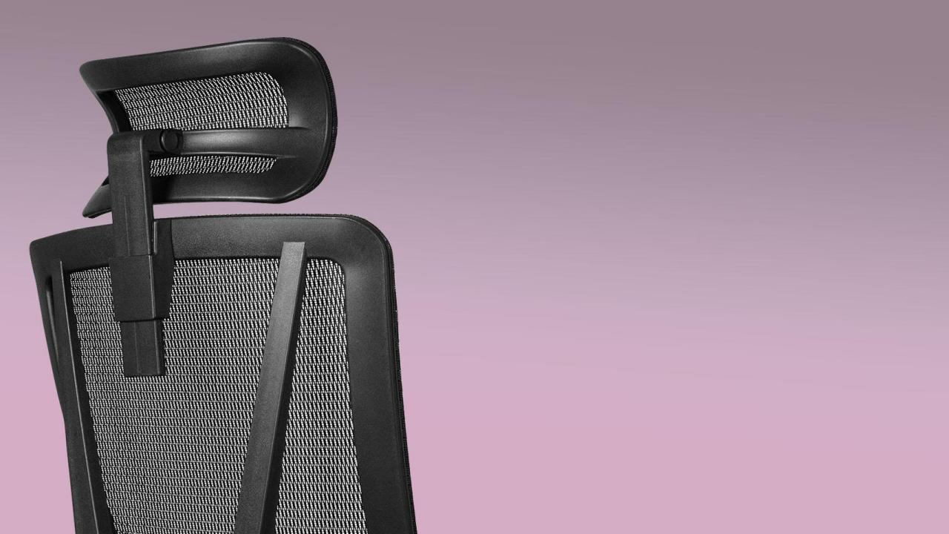
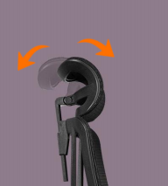
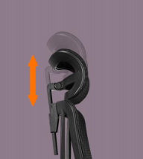
3D large curved headrest
Help the cervical spine decompress
STREAMLINE INTEGRAL CHASSIS
Lifting and rotating headrest, flexible angle adjustment. 30cm widened headrest,
Effectively relieve neck pressure.
115MM super large headrest spacing adjustment, Suitable for people of different heights.
Rotation adjustment
adapt to different postures
Lifting adjustment adapts to different heights

Slide 6
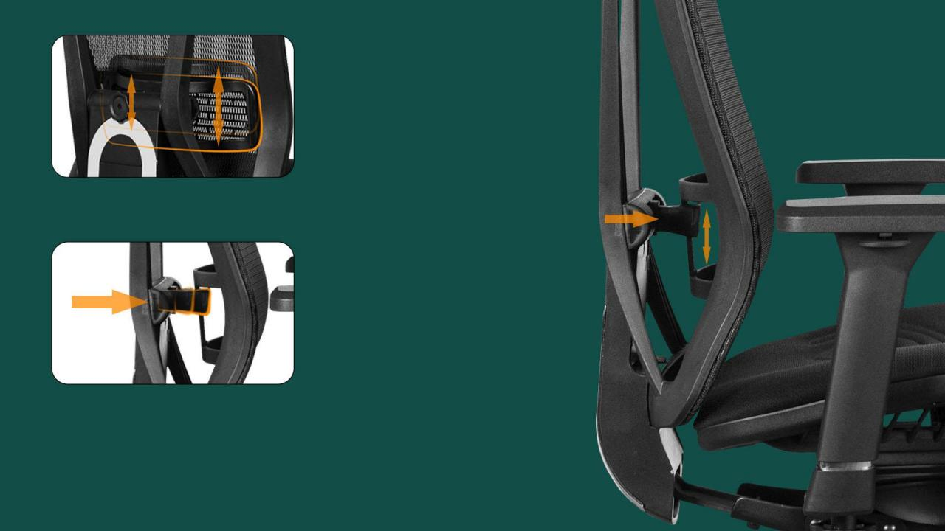
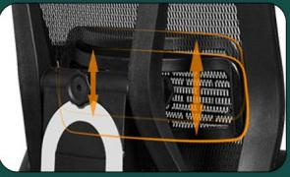
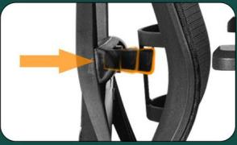
Real-time perception of lumbar support
Accurately find the support position
The lumbar is adjusted forward and
backward to better fit the waist line.
Adjusting the lumbar up and down to make the waist more comfortable.

Slide 7
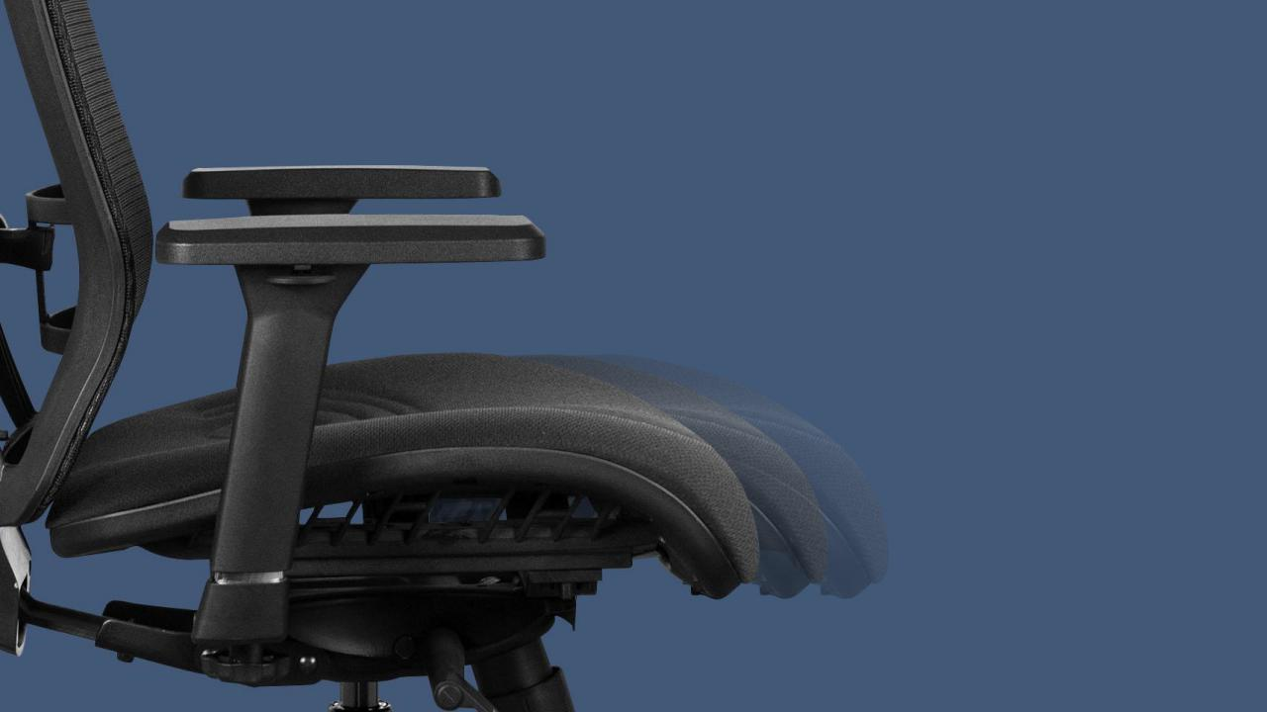
Seat can be adjusted for depth, it’s about 5cm.
Sliding seat can meet different users’ demand.
The seat with sliding function (the depth of the seat can be adjusted), the hollow mesh design is more comfortable to sit and maintains effective support for the thighs.

Slide 8
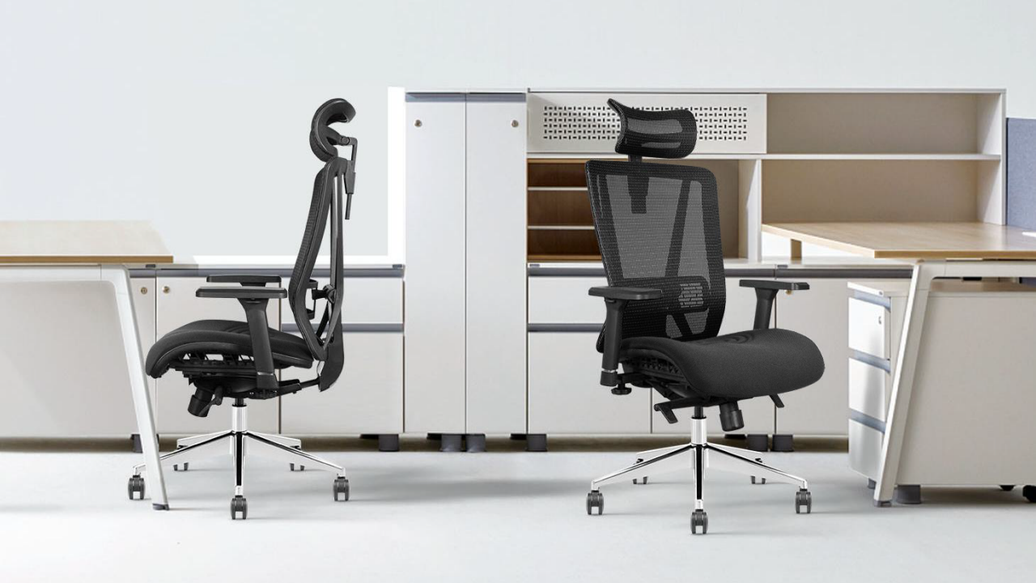
MODERN MIXED STAFF SPACE

Slide 9
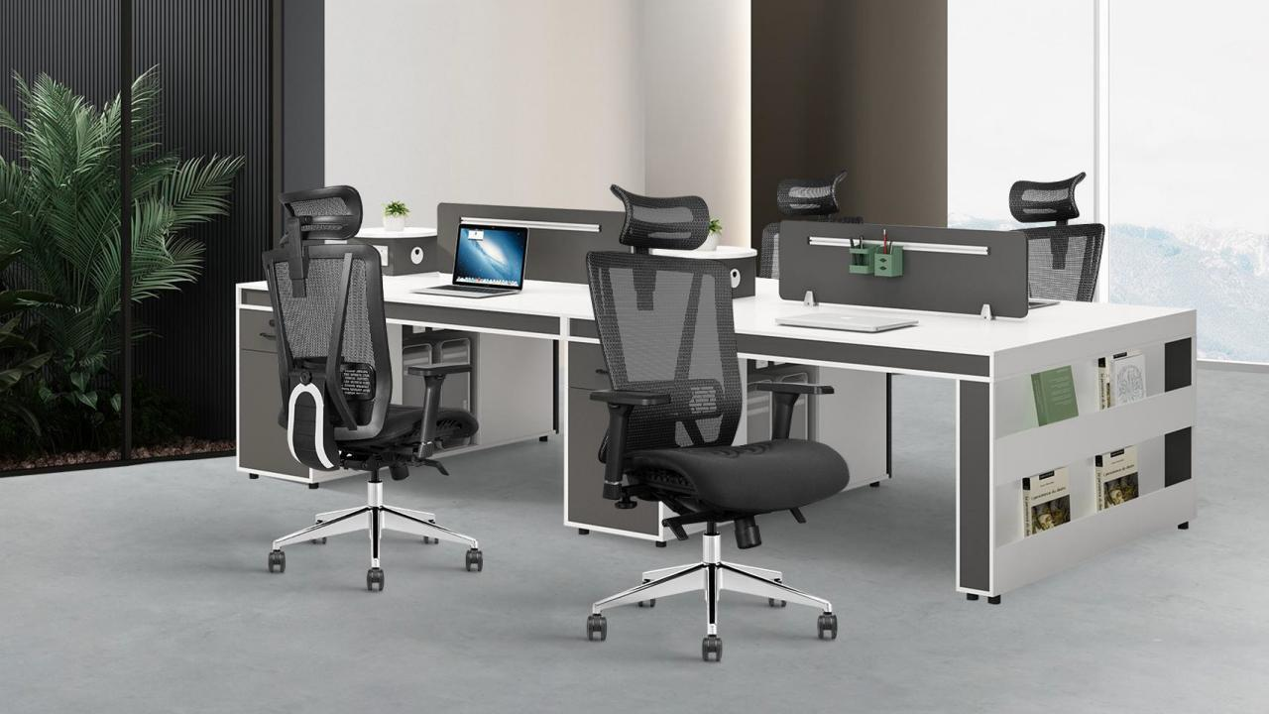
INTEGRATED STA F F SPACE

Slide 10
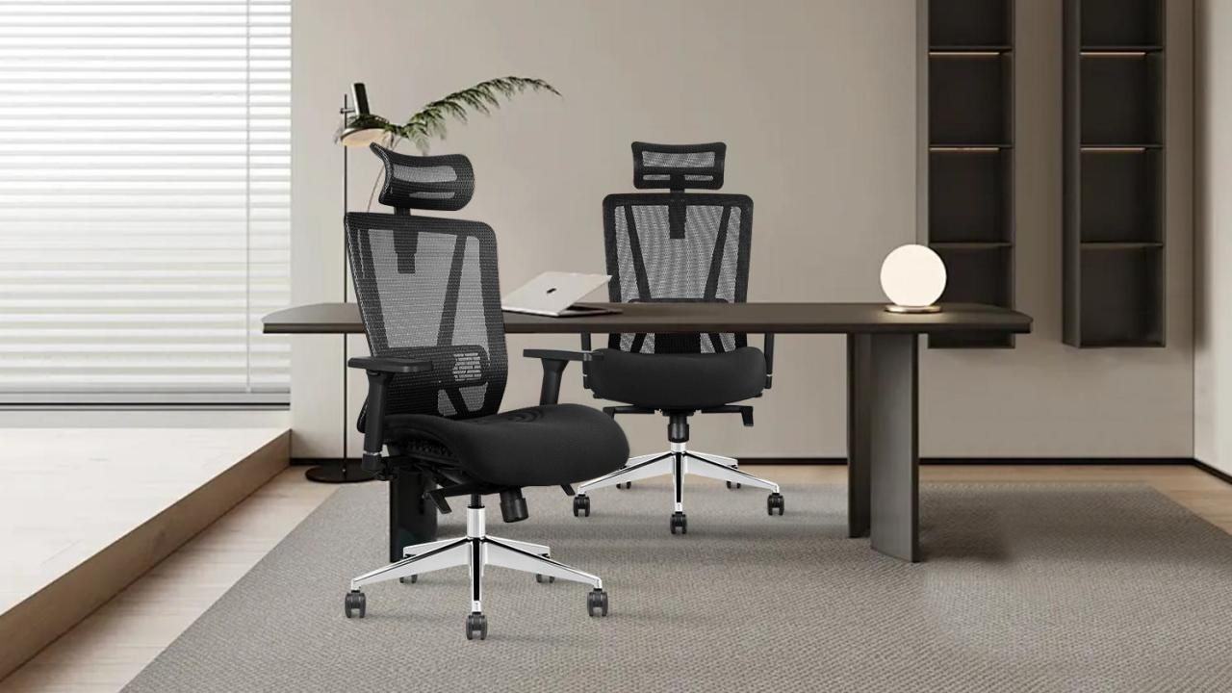
MANAGER WORKING SPACE
Premium office chair, the nifty and elegant design blesses your eyes. Having one of this chair can not only disclose your unique taste, meanwhile it can also greatly relieve pressure from working.

Slide 11
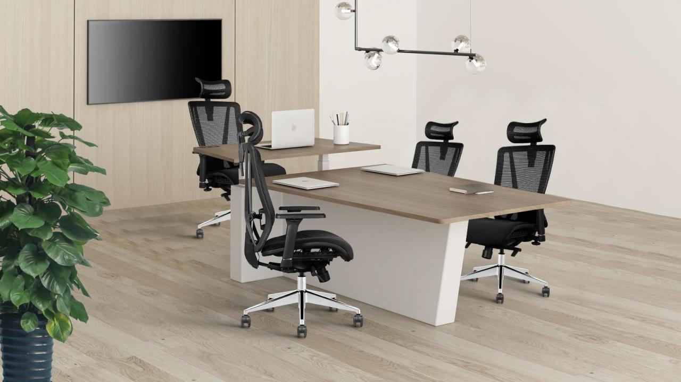
MODERN MIXED STAFF SPACE

Slide 12
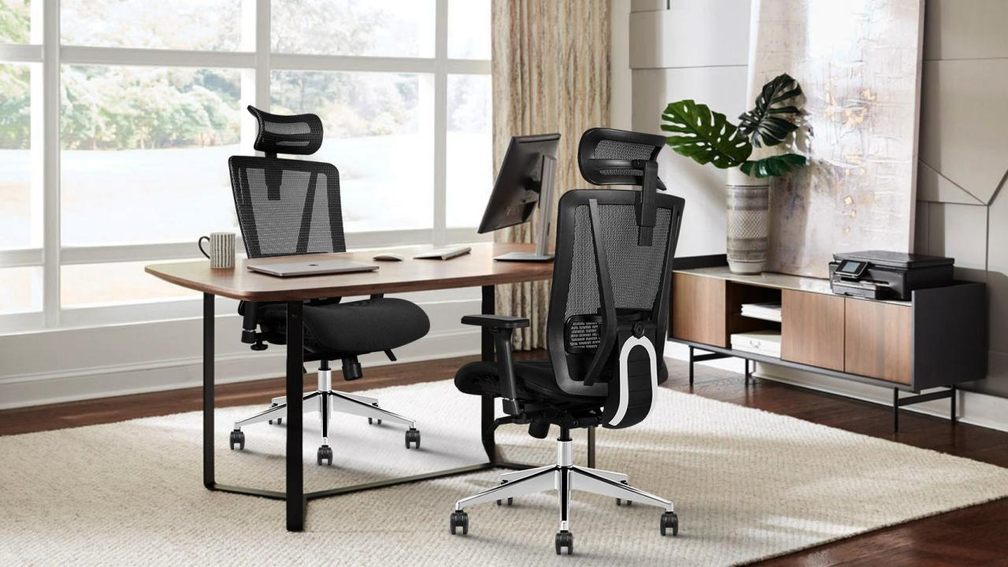
MODERN MANAGER SPACE

Slide 13
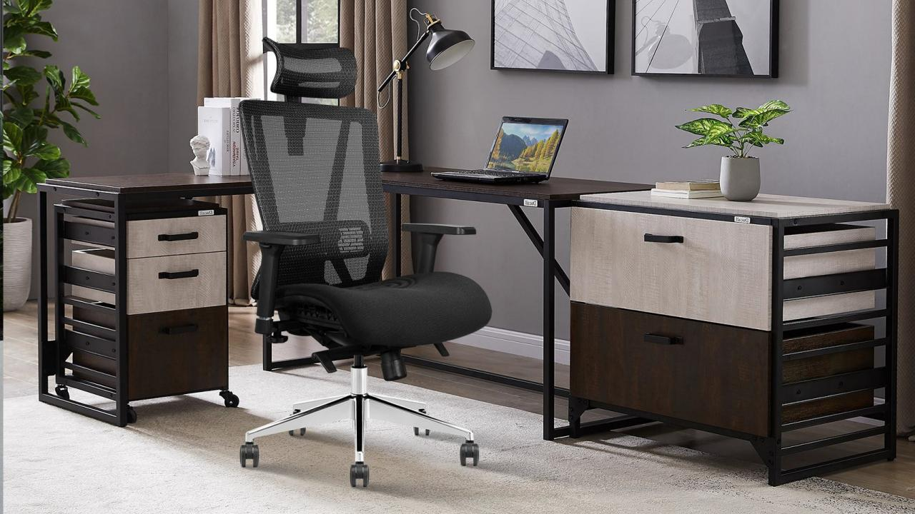
BOSS WORKING SPACE

